Slide 1
IT204F Presentation
By: Zheming, Ameer, Jackie, Kai Yi
Notes:
Zheming

Slide 2
Table of contents
01
02
03
04
Introduction
Business Needs
IT Solution
How It Helps
Notes:
Zhe Ming

Slide 3
01
Introduction
Notes:
Zhe Ming

Slide 4
Introduction
Technology has advanced rapidly over the years, leading to many industries transitioning to the digital world.
One of the industries is the entertainment industry; used to be via physical performances like a circus or opera. Now is through digital platforms like Youtube or Facebook.
One problem in the children’s entertainment industry is that most parents are not always able to give children their time and need to distract them with something entertaining while they are preoccupied with their own things and work.
Hence, we plan to make a platform that contains various entertaining and educational games fit for the children’s entertainment industry for those aged between 6 and 12 years old.
Notes:
Zhe Ming

Slide 5
02
Business Needs
Notes:
Ameer

Slide 6
Business Needs
Entertainment
Games
Education
Educational Games
Convenience
Ease of use
Demand
High demand for such applications
Notes:
Ameer

Slide 7
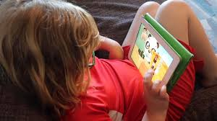
Entertainment
Entertain children with interesting games while parents are busy
Parents are sometimes unavailable as they are busy with their own affairs
Screen time for children from 6 to 8 years old - Not more than 1 hour a day
Screen time for children from 9 to 12 years old - Not more than 2 hours a day
Notes:
Ameer

Slide 8
Demand
Decline of physical toy
Due to closure of toy stores like Toy“R”Us which reduce the amount of physical toys in the market
This creates a demand for entertainment as there is a lack of physical toys for entertainment for the children
Our game aims to meet the demand by making it fun, entertaining and convenient.
Notes:
Kai Yi

Slide 9
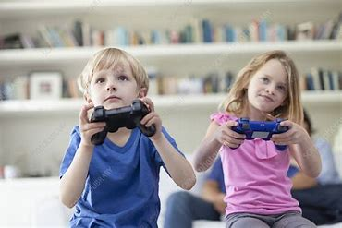
Education
Education for kids at a young age is important. Research has concluded that a child’s brains are more open to learning new skills like reading, writing or playing a physical instrument.
When children start to learn earlier at a young age, they are able to perceive and understand better while at the same time developing their brains functionality.
Furthermore, children at a very young age to develop emotions has always been something a parent would want their child to have. Having to use entertainment to educate kids on emotions is a better way for them to understand emotions better.
However, it is not always good to educate children's emotions through entertainment. It would be best if the parents are there to educate their child physically.
Notes:
Zhe Ming

Slide 10
Convenience
Physical toys require space.
Not every household has the space to support a wide variety of toys.
Cleaning up and packing up toys is time-consuming.
Digital entertainment is more convenient for children and parents.
Notes:
Jackie

Slide 11
03
IT Solution
Notes:
Ameer

Slide 12
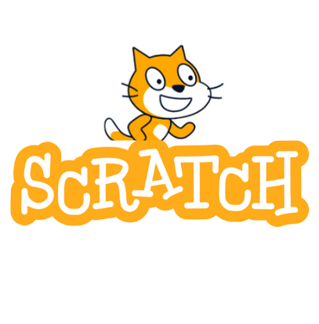
Development
Tool
We plan to make an application that is a platform that contains various entertaining and educational games fit for the children's entertainment industry. This is to solve the problem of many children that have busy parents. By having this application, children would keep themselves entertained and educate themselves through the games in our application.
Notes:
Ameer

Slide 13
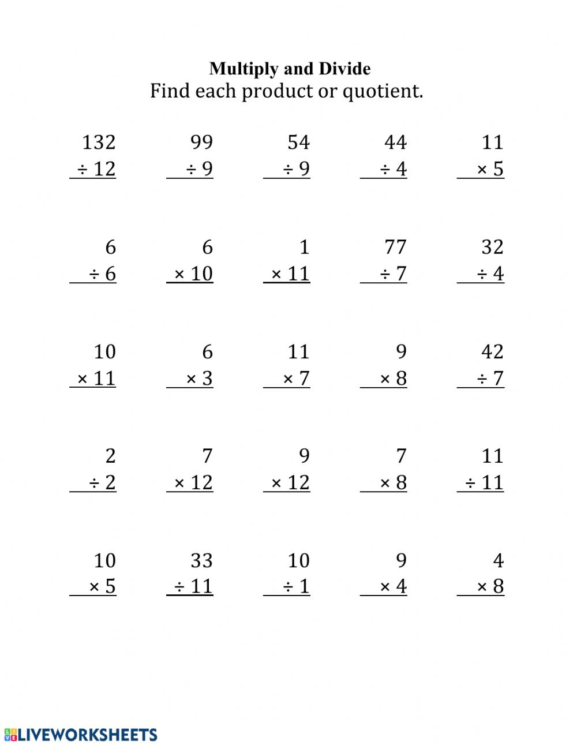
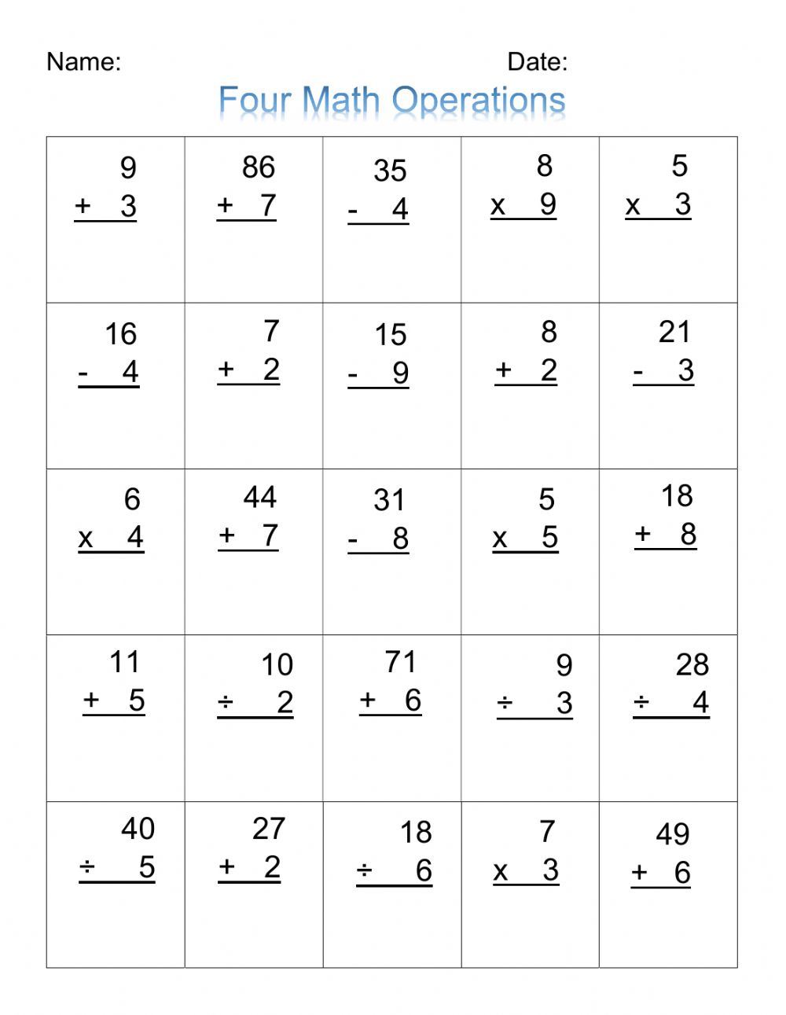
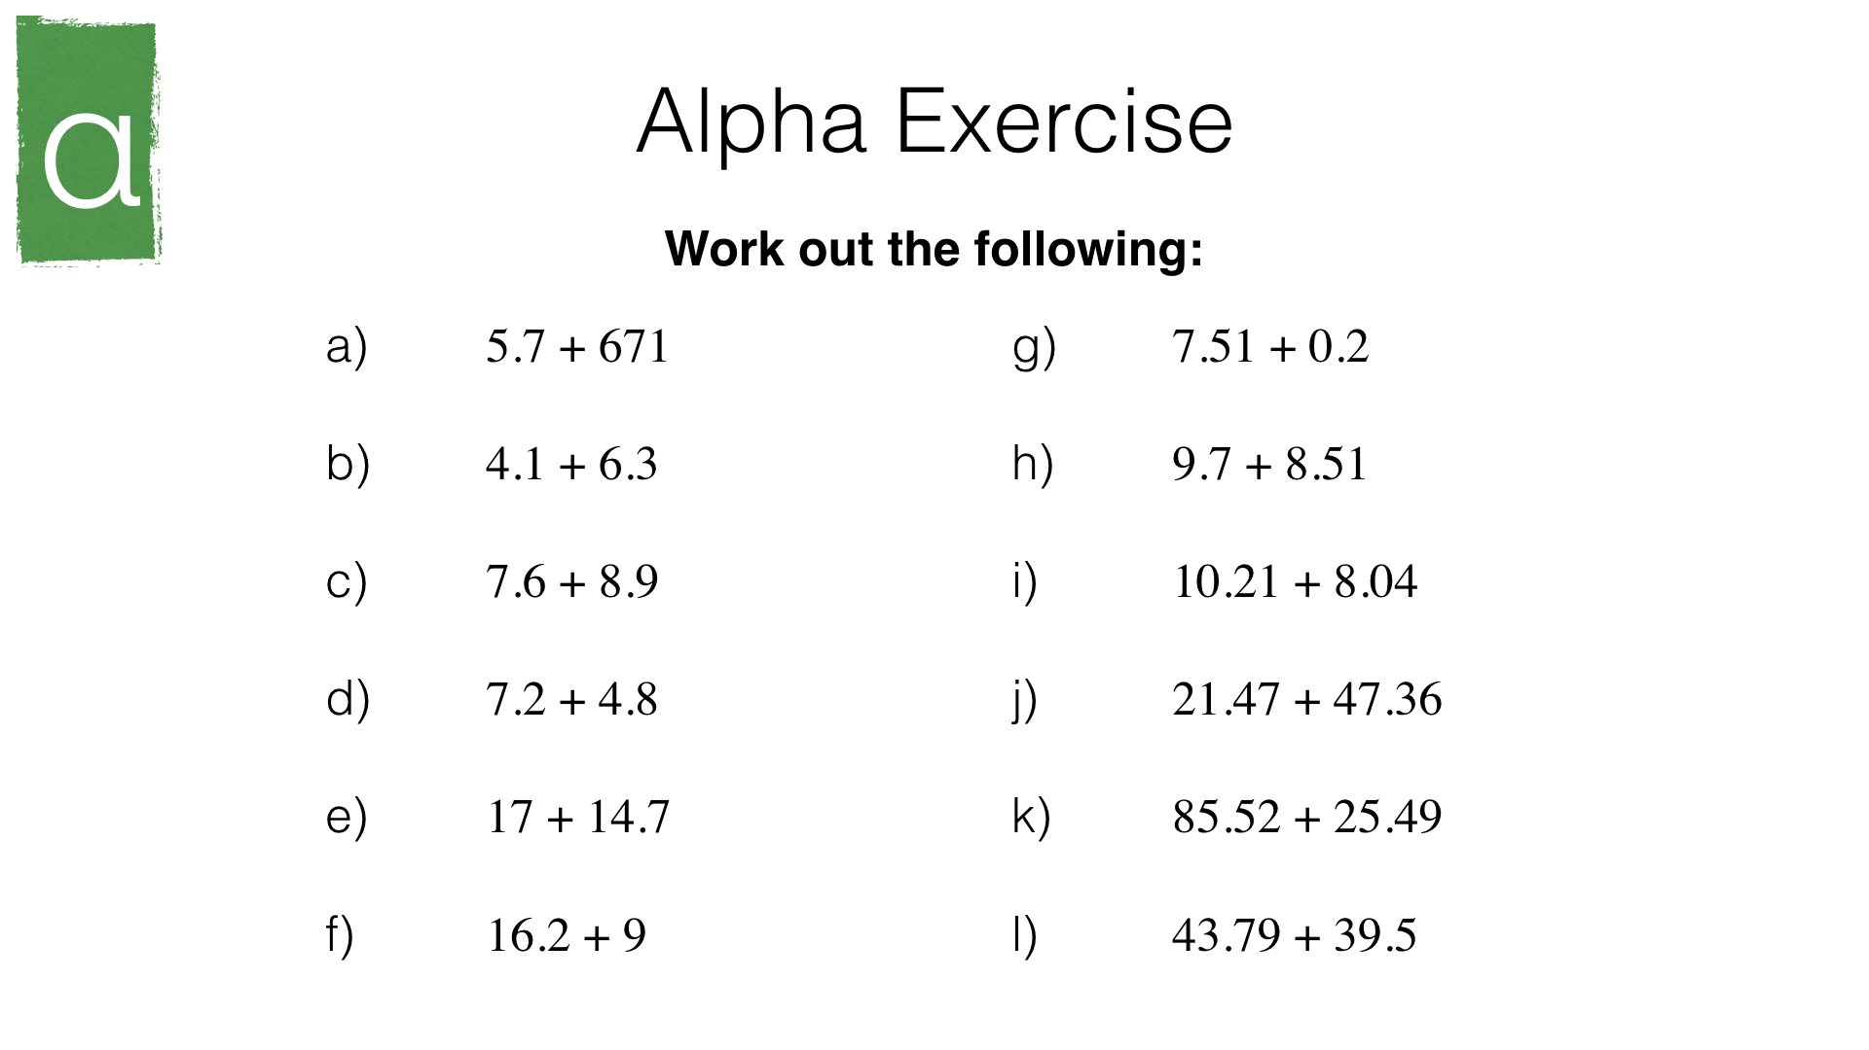
Math Quizzes
Simple math quizzes with different levels of easy, medium and hard.
Each level consist of 15 question testing on addition, subtraction, multiplication and division.
When score reaches 25, game is over.
User can choose any level of difficulty they want.
Notes:
Ameer

Slide 14
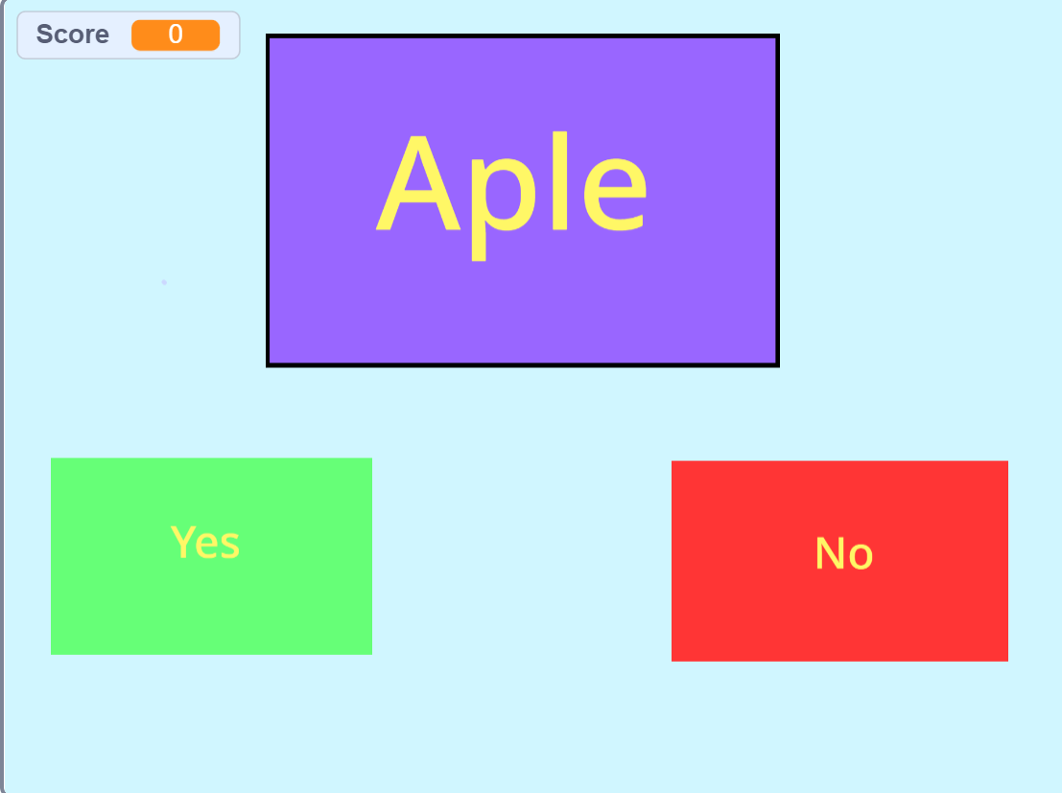
English Quizzes
Basic English quizzes with different levels of difficulties for easy, medium and hard
Test on basic grammar, vocabulary and spelling
For example for spelling, “Is the word ‘aple’ spelled correctly?” where the answer is no
‘Yes’ and ‘No’ buttons will be displayed. If correct button is clicked, they would gain 1 point.
If the question is answered correctly they would gain a point.
The game would end if 5 points have been earn or if multiple mistakes have been made.
Notes:
Kai Yi

Slide 15
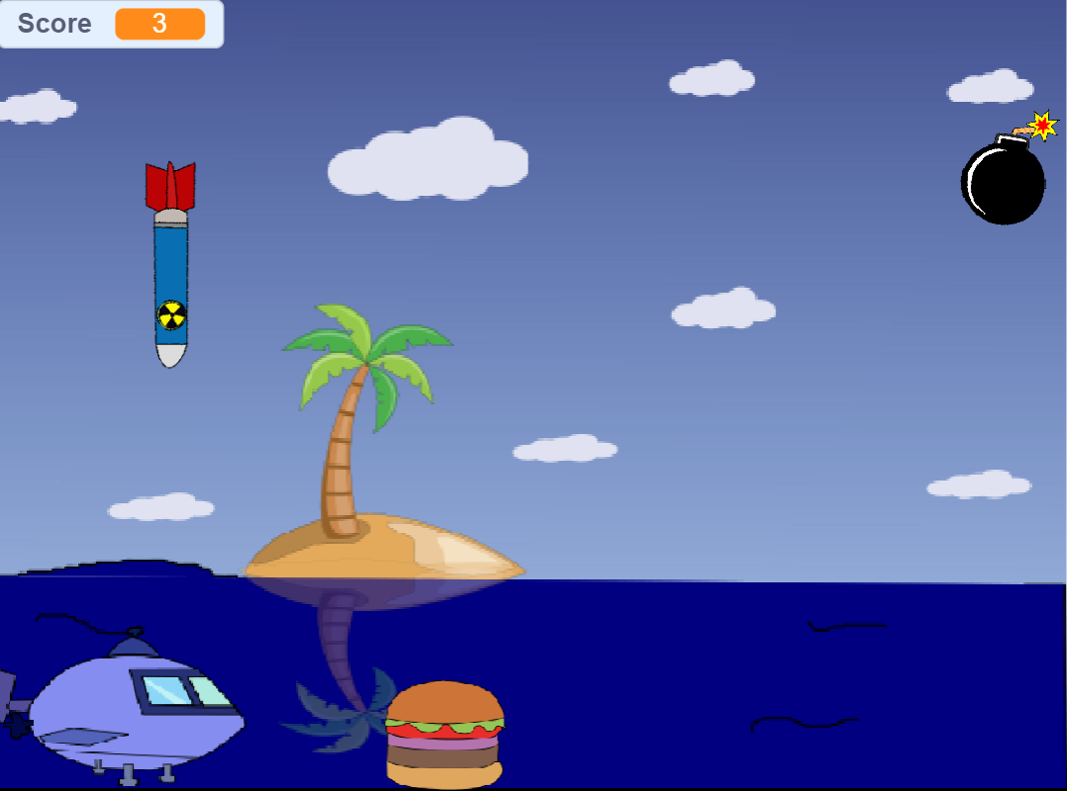
Spongebob Burger Collectors
An exciting game with a Spongebob Squarepants theme
The goal of the game is to collect a certain number of burgers and avoid bombs to win the game.
Bombs and Burgers will be randomly dropped down from the top of the screen.
Players must make use of the left arrow key and right arrow key to avoid the bombs and at the same time collecting the fallen burgers.
To get one score, players have to use the boat and collect a burger.
One score will be deducted if the boat touches the bomb.
The game ends when the number of scores reaches 30 or reaches 0
Notes:
Zhe Ming

Slide 16

Emotion Game
A game where it teaches children about emotions.
There will be icons on the screen that show different emotions like Angry, Sad, Excited, Happy.
When clicked on the angry face icon in the game, the face of the sprite will change to an angry face, followed by the sound of anger
Similarly when clicked on any other emotion icon, the face of the sprite will change to the emotion icon that was chosen. Accompanied by the corresponding sound.
Notes:
Zhe Ming

Slide 17
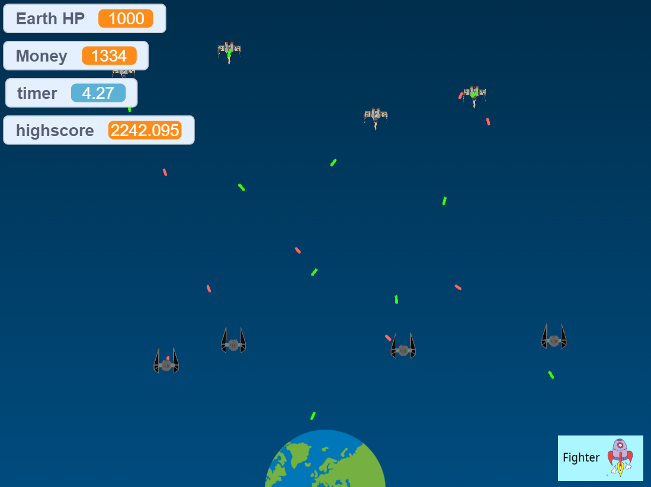
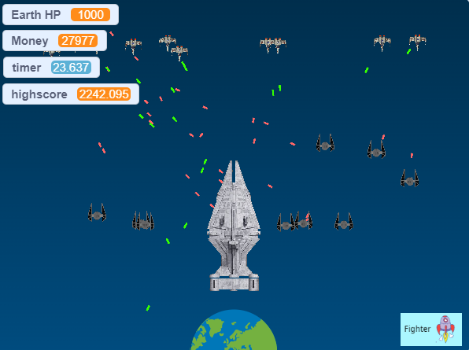
Space Defender
The goal of the game is to survive the attackers.
To win, players must survive 10 waves of attacks.
Each wave gets progressively harder.
Each wave will have attacking ships.
Players must use their money wisely on ships to defend Earth.
Players earn money by defending mining outposts and surviving.
There is an endless mode to see how long someone can survive.
Notes:
Jackie

Slide 18
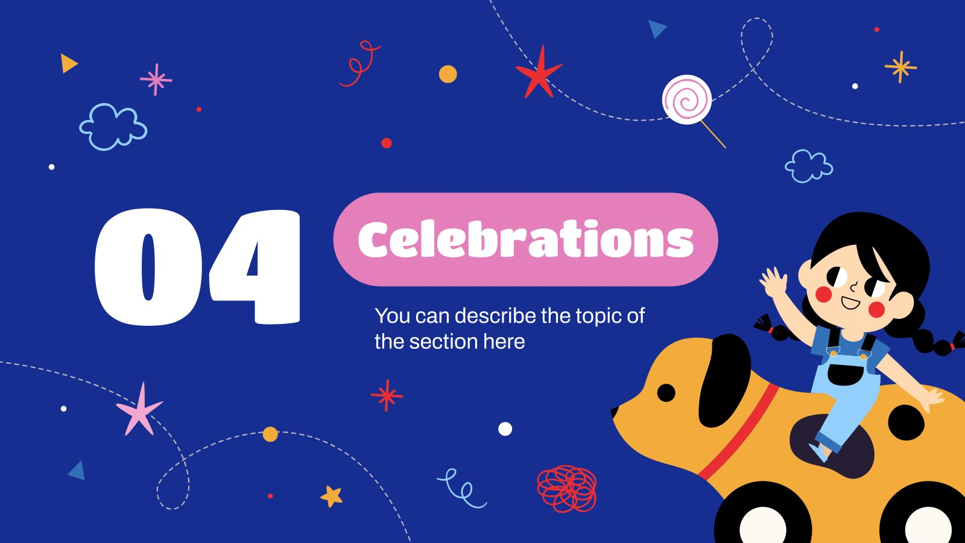
How It Helps
Notes:
Ameer

Slide 19

How it helps the business
Empathy For Users
Business Value
Feasibility
Realistic
Practical Workflow
Notes:
Ameer

Slide 20

Realistic
This application is realistic as it is easily implementable.
Generally, all children or parents have a smartphone these days, allowing our application to be easily distributed to their devices since it is software.
It is easy to use and set up on any mobile device.
This allows parents to give their children the entertainment they need while they are busy with something else, no matter what time it is or where they are.
Notes:
Ameer

Slide 21

Feasibility
This application is feasible as it can be easily created with basic software like scratch.
Our application consists of simple games such as simple mathematics and English quizzes, simple collect and avoid games and a space defender game and so on.
All these games are simple, easy and uncomplicated to play and understand.
This allows the children to play the game without supervision from their guardian thus making it feasible for children to play.
Notes:
Kai Yi

Slide 22

Empathy For Users
This application empathises with working parents that do not have time to educate and entertain their children by having games in place to facilitate their child's learning
Our application has a variety of games like Math Quizzes, English Quizzes, and Strategic Games as well as an emotions display function.
Having these games in place helps their child to learn the same things in alternative to their parents that do not have time to cater for them.
Notes:
Zhe Ming

Slide 23

Business Value
It fulfils the business needs of this industry.
It fulfils the need of educating children on basic thinking skills and fulfils the need for entertainment with fun and engaging games.
It being digitised makes it convenient as all users need to do is download and open the app on their mobile devices or tablets. There is no need to pack up after playing.
This digital innovation sparks interest in the entertainment industry and helps increase the demand.
Notes:
Jackie

Slide 24

Practical Workflow
Once the application platform that contains the game is made, more games can be added in future.
The current 5 games, 3 of which are educational and 2 of which are entertainment, already fulfil the business needs and digital innovation that this industry requires.
As more games are added on, it helps expands the application and the demand for it.
Notes:
Jackie

Slide 25
Thanks!
Do you have any questions?
Notes:
Jackie

